Slide 1
6MMCS002W Digital Marketing, Social Media & Web Analytics
Week4 –Search engine optimization techniques part B
Dr Vassiliki Bouki, M. Margeti
boukiv@wmin.ac.uk

Slide 2
Introduction
Last week we talked about ‘on-site’ and ‘off-site’ SEO techniques, and we categorised them as follows:
1. Keywords and site content [on-site SEO] (covered week 3)
2. Site organization and technical SEO (domain name; URLs, root domains & sub domains; structure; navigation; internal linking; meta tags – snippets; sitemaps.xml and robots.txt) [on-site SEO]
3. Backlinks (external links) [off-site SEO]
Optimization via social media, could be considered under the ‘backlinks’ technique
This week we’ll talk about 2. and 3.
Also, we’ll discuss:
White and Black hat optimization

Slide 3
SEO: Site organization
Make your site visible to search engines by always following some principles:
a) Domain Name – optimize your domain name (some ideas):
Use one of your main keywords in the name V.I.
Make domain unique (not to be confused)
.com
Easy to type
Easy to remember
Make it short (or long?)
Fulfil expectations (etoy.com example)
Do not follow latest trends, if they do not serve any purpose!

Slide 4
SEO: Site organization
b) URLs
Which URL is ‘better’?
http://www.bbc.co.uk/news/technology-25826678
http://www.theguardian.com/technology/2014/jan/22/facebook-princeton-researchers-infectious-disease
Why? (Remember how spiders/SE work)
URLs and keywords
c) Root domains & sub domains
Avoid multiple sub domains – they become unnecessarily long.
Consider main domains

Slide 5
SEO: Site organization
d) Structure
Logical based
Category clustering
Flat vs deep website. Flat is better for users and search engines. Ideal: for any site with less than 10,000 pages everything should be accessible within 3 clicks.

Slide 6
SEO: Site organization
e) Navigation
Text based navigation
Beware of ‘spider traps’ (HTML code 301 ‘moved permanently’ and HTML code 302 ‘found’ http://www.w3.org/Protocols/rfc2616/rfc2616-sec10.html)
Pages that require specific cookies / sessions are NOT accessible by spiders
Server / Hosting problems – choose your hosting environment carefully
Create links to pages you want to be visible to spiders – include them in the main navigation bar.

Slide 7
SEO: Site organization
f) Internal linking
Linking pages inside the site is a powerful SEO tool that developers tend to ignore.
It does not only help spiders but humans as well!
Examples of internal linking: compare products and link the name of each product with the product name; further content that expands topics, provides explanation / clarification / further information; FAQs that link to internal pages (these are just few examples).
(The following article presents a study / experiment on how changing the internal links affected the ranking of the site http://ezseonews.com/backlinks/internal-linking-seo/)

Slide 8
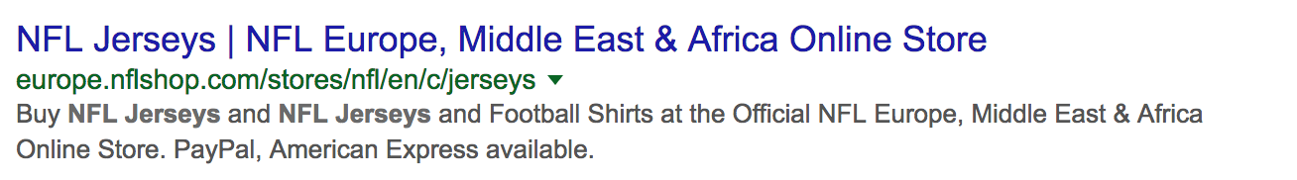
SEO: Site organization
g) Meta tags and snippets
What is a ‘meta tag’?
A bit of code that controls how your site will look in the listing.
E.g.
<title> NFL Jerseys </title>
<meta description=‘Buy NFL Jerseys and NFL Jerseys and Football Shirts at the Official NFL Europe, Middle East & Africa Online Store. PayPal, American Express available.’/>
In the search engine’s results page the above will appear as:

Slide 9
SEO: Site organization
g) Meta tags and snippets
Using snippets (or ‘rich snippets ’) you give users a sense of what the page is about and why it is relevant to their query.
Over time snippets have involved from a pure text format to include video, music info, business organisations, etc. This type of snippets provide more catching eye options than the pure textual results.
Google recommends Microdata as a mark-up format for creating snippets.
Bing and Yahoo has also joined Google and also support it. (source: http://blog.schema.org/search?q=Google+Bing)
Microdata can:
extend HTML5 and add extra semantics.
help the search engines understand the semantic focus of certain pieces of content on our page
present users with more information about the page on the SERP.

Slide 10
SEO: Site organization
g) Meta tags and snippets
Schema.org provides a collection of schemas (e.g. html tags) that developers can use to markup their pages in ways recognised by major search engines.
Schema.org is not the only specification for Microdata. But we choose it because according to Google: “It lets you mark up a much wider range of item types on your pages, using a vocabulary that Google, Microsoft, and Yahoo! can all understand.”
Schema.org uses HTML5 Microdata with new elements like <time>
although, it still uses examples with <div> and <span>, which we will try to use in our examples more <section>, <article> etc.
Based on schema.org specification, Microdata defines:
Generic item types (“Thing”) such as Person, Event, Place, Product, Book, Article etc.
Properties. each Generic item type has properties whose values can be: text, URLs, number, date etc.

Slide 11
SEO: Site organization
g) Meta tags and snippets
How to extend your html page with Microdata – An example
Decide the piece of content on your html page, to which you want to give more semantic focus.
Let’s say you implement an “About me” page, so the information is about a person.
Go to http://schema.org and check which generic item type (Thing) can describe best this piece of content. In our example, the generic item type is Person.
So we have to apply the relevant microdata vocabulary found in: http://schema.org/Person
Create a <section> or <article> or <p> html element around your content. Include, in the opening tag, the attributes: itemscope and itemtype.
Itemscope works along with item type to specify that the HTML contained in a block is a about a particular item. Itemscope creates the item and defines the scope of the itemtype
itemtype specifies the relevant microdata vocabulary (in other words it defines which schema you will use)

Slide 12
SEO: Site organization
g) Meta tags and snippets
Example
‘About me’ page
HTML
<p> Dr Vassiliki Bouki </p>
<p> Principal Lecturer </p>
<p> 02079115000 </p>
HTML with microdata
<article itemscope itemtype=http://schema.org/Person>
<p itemprop="name"> Dr Vassiliki Bouki </p>
<p itemprop="jobTitle"> Principal Lecturer </p>
<p itemprop="telephone"> 02079115000 </p>

Slide 13
SEO: Site organization
g) Meta tags and snippets
Always fill meta tags – otherwise SEs will automatically take text out of your site. This might not look well and you lose the control.
Include meta-tags for all elements – not only the description of your site
Use your keywords

Slide 14
SEO: Site organization
h) ‘Sitemaps.xml’ & ‘robots.txt’
Search engines automatically look for a special file on each website called ‘sitemaps.xml’ – it is a map of your site
You can create it automatically using online tools. E.g.:
XML Sitemaps Generator: http://www.xml-sitemaps.com/
When the file is generated, upload it to the main directory and submit it to Google Webmaster Tools (if you use this tool)
Make sure you do NOT have a ‘robots.txt’ file
A ‘robots.txt’ file is a plain text file that blocks areas of your site to be fount by search engines using ‘Disallow: / page_name’

Slide 15
Changes & suggestions from Google about site organization
Google constantly reconsiders the algorithms used and what is important for SEO. Recent remarks / changes in relation to ‘site organization’:
Domain name → Exact Match Domain name (EMD). EMD was considered a good practice. Not necessarily any more.
EMD is a domain name that matches precisely a targeted search engine query to obtain high rank in searching for this query (main keyword = domain name).
Does EMD offer advantages?
True in the past – less true now. September 2012 ‘reduce ranking ability over poor quality EMDs’

Slide 16
Changes & suggestions from Google about site organization
EMD that lost ranking: http://moz.com/blog/googles-emd-algo-update-early-data
There is no sign that Google penalises EMD – Google scrutinises these sites much more.
IF sites show other signs of low quality (lot of links; keywords etc) then the EMD is considered negative.
What about brand names?

Slide 17
Changes & suggestions from Google about site organization
URLs; root domains & sub domains; structure; navigation; internal linking: no significant changes although most of these techniques are related with the quality and the correct use of keywords.
Meta-tags (not exactly change / more misinterpretation): tags are NOT long lists of keywords. Google does not like tags that look like long list of keywords ; duplication.
Latest on snippets (December 2017 & January 2018):
How Long Should Your Meta Description Be? -- 2018 Edition (Moz)
Google officially increases length of snippets in search results (SEL)
sitemaps.xml and robots.txt: no changes
Back

Slide 18
SEO: Backlinks
The last SEO technique we’ll examine is ‘back-links’.
This is an off-site technique.
In the past ‘back-links’ were misused and this made Google to introduce ‘Penguin’ algorithm.

Slide 19
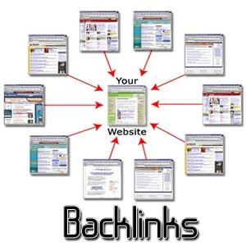
SEO: Backlinks
Links from other sites that point to your site is the main off-site SEO technique.
They are also called: inbound links, external links(?), inlinks, inward links.
Some examples of links:
Facebook shares
Total facebook activity
Facebook comments
Facebook likes
Tweets
Blogs
Other Sites
Authors

Slide 20
SEO: Backlinks
The number of backlinks is often used by SE as the most important factor for determining the site’s engine ranking, popularity and importance.
According to Google’s founders ‘a link to a site is a vote for this site’.
One website pointing to your website means: ‘I trust you enough to refer to you and even send traffic to your site.’
“The best way to get other sites to create relevant links to yours, is to create unique, relevant content that can quickly gain popularity in the Internet community. The more useful content you have, the greater the chances someone else will find that content valuable to their readers and link to it. Before making any single decision, you should ask yourself: Is this going to be beneficial [and useful] for my page's visitors?” (Source: Google)

Slide 21
SEO: Backlinks
Main things that matter for search engines:
Number of links pointed at your site
Quality of links:
Authority (how long they exist, people behind them are leading experts in the field e.g. long-run sites, professors etc))
Trustworthiness (links are from well-established / recognised organisations e.g. Universities, government etc)
Relevancy (directly related to your business e.g. ’Financial Times’ point to a business vs ‘personal blog’ that point to the same business).
Search engines take into consideration:
How relevant backlinks are to your industry and field.
How long they exist as a website and as an organization.
Whether the people behind these websites are leading experts in your field or industry.
How close they are to your business address (e.g. local directories). (Source: Google)

Slide 22
SEO: Backlinks – building
How can you ‘create’ back-links?
Building back-links:
A) Submit your website or business to different web directories but be very selective:
Don’t submit to spamming directories which advertise that they will submit your website everywhere for £2.
Check whether these directories have strict guidelines which accept only relevant and trustworthy websites. Avoid directories which don’t have guidelines.
Submit to local business directories.
Submit to specialty-directories, e.g. list services unique to your industry
Always be careful where you submit your website!

Slide 23
SEO: Backlinks – building
Building back-links:
B) Gain links from other websites or blogs
Good content can do this on its own sometimes
But, sometimes you have to contact people personally.
Find websites or blogs with relevant content to yours.
Contact experts in your field or industry, and let them know that you have content which relates to their content.
Ask them to publish a link to their blog or website. In this way you gain a very trustworthy link.
C) Finally, explore the backlinks of the competitors who rank well and try to get linked to the same websites.

Slide 24
SEO: Backlinks – who points to your site?
How to find out who points to your site?
You can submit a web address (your web address or a competitor’s web address) online and find out what are the backlinks.
http://www.opensiteexplorer.org/ (limited number of reports)
Go to the above address and type any web address you like. E.g. try: ‘westminster.ac.uk’

Slide 25
SEO: Backlinks – tools
Tools for analysing, building and maintaining high quality links
ALEXA
http://www.alexa.com
In ‘Features’ section you can find the option: ‘Competitor Backlink Checker’

Slide 26
SEO: Backlinks – tools
Tools for building and maintaining high quality links
Raven Tools:
There is a free trial but it takes time to set up. The Link manager of this tool helps to:
Manage your outreach efforts
Monitor your progress of our outreach efforts from the moment you try to get the backlink to the moment search engines discover the backlink.
You can organise according to: status of outreach, what kind of link it is, who is responsible for this link, URL of website you try to get.
When your links are up on that website you can also add the URL and anchor text of your link which the tool will monitor over time (reporting on status and even link value).
Read the following before you start (url-builder):
https://raventools.com/marketing-reports/google-analytics/url-builder/

Slide 27
SEO: Backlinks – problems
‘Back-linking’ was a technique heavily misused by developers in the past.
‘Link – farming’: web sites created for link purposes only.

Slide 28

SEO: Backlinks – problems – Penguin
Google strikes back…
What is ‘Penguin’?
Another algorithm from Google released in 2012 (more updates 2013-4 till today). Mainly targets spam links. Sites were degraded.
In order to create many links developers tended to exchange links / ‘cross-linking’, to buy links, to create ‘link farms’ (‘niche sites’) etc.
It is not only that sites will not get good ranking – sites are punished:
Dropping a website in rankings for minor things
Dropping a website altogether for major things

Slide 29
Other areas of concern?
“Authority – authority – authority”
“Authority” seems to be the new motto of Google.
AUTHORITY where?
Site;
Links;
Blogs → AUTHOR / AUTHORS
Site: time
Links: take care if links that point to your site are not respectful. You can report them in webmaster tools.
Blogs: build the authors fame / ranking

Slide 30
Other areas of concern?
TIME
Search engines can ‘take their time’ to:
discover changes on your website
re-assess the relevance and authority of your website
Also,
Developers and SEO experts must dedicate time on SEO, monitor and improve the site and SEO techniques constantly.
SEO is not an one-off task.

Slide 31
Other areas of concern?
In order to ‘target’ blogs Google checks the ‘reputation’ of the author.
Authority of authors (in blogs) http://www.youtube.com/watch?v=IMxC3wQZOyc#t=41
Guest blogging as a way to get more links:
The decay and fall of guest blogging for SEO
Back

Slide 32
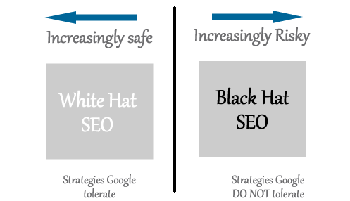
White & Black Hat SEO
What is ‘White Hat’ and ‘Black Hat’ SEO?
Advice... https://www.youtube.com/watch?v=6AmRg3p79pM
Figure from ‘SEO 2013 & Beyond, A. Williams

Slide 33
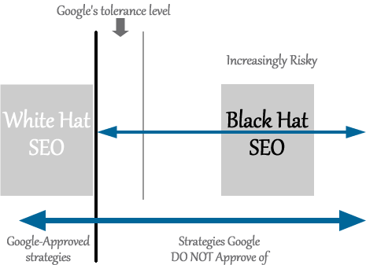
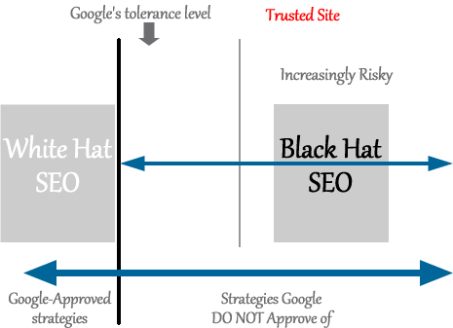

White & Black Hat SEO
Over-optimization’: optimization beyond the ‘tolerance level’.
What is the ‘tolerance level’?
It seems that the ‘tolerance level’ is not the same for all sites...
Figures from ‘SEO 2013 & Beyond, A. Williams

Slide 34
‘Grey Hat’ SEO
SEO techniques that take more risks than white hat SEO techniques but aren't likely to get your site banned from search engines.
They're questionable SEO techniques but not in the same category as black hat SEO techniques. However, what's considered gray hat SEO today might be black hat SEO next year E.g.
A) Duplicate content
B) Paid links (difficult to prove)

Slide 35
Black Hat SEO
What can I do if...
My site is not listed at all?
If it is a new site you might just need to wait
Monitor closely your site
Built links
Confirm your keywords
Take care of your content
My site’s ranking has dropped off?
Rethink SEO approach
Make sure there are no ‘bad’ backlinks – You can inform Google in this case
Check what your competitors do
In most cases SEO problems are recoverable
In extreme cases you might need to start a new site

Slide 36
White & Black Hat SEO
SEO is not about QUANTITY any more – it is about the QUALITY
The message Google sends to web developers is clear:
focus on users – not search engines
http://www.youtube.com/watch?v=y8s6Y4mx9Vw&list=SP3ABD5CD91559A1DC

Slide 37
Discussion
Fair or unfair changes? What are your views?
How do you feel about Google?
A power game?
What if they decide to consider links from Facebook no quality links?
From 2011 we have reactions that Google does this in order to increase advertisements. Is it really fair?

Slide 38
Next week
So far, we have seen how search engines work; SEO techniques, how SEO techniques have changed over time.
We talked about keywords, site organization an backlinks as SEO techniques as well as PANDA and PENGUIN algorithms.
Next week we will talk about social networks and how they are related to SEO.

